Slide 1

CSC364-Software Engineering Week-6 Lecture-11 Semester-# Fall 2018
Prepared by:
M. Sajid Farooq

Slide 2
SDLC
Software Development Life Cycles

Slide 3
Chapter Contains
Waterfall
Incremental
RAD
Incremental Development Model
Evolutionary
Specialized process
COTS
Formal Methods
Unified process

Slide 4
Kinds of SDLC Models
Water fall model
The incremental model
The RAD model
Prototyping
The spiral model
The concurrent development model
Component based development
The formal methods

Slide 5
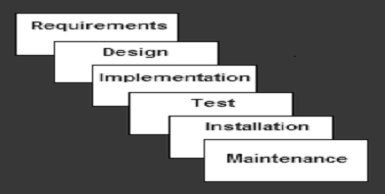
The Waterfall Model
Example: Accounting System

Slide 6
The Waterfall Model
Strengths
Easy to understand, easy to use
Sets requirements stability
Good for management control (plan, staff, track)
Works well when quality is more important than cost
Linear in nature

Slide 7
The Waterfall Model
Deficiencies
All requirements must be known upfront
Can give a false impression of progress
Does not reflect problem-solving nature of software development
Little opportunity for customer to preview the system
Blocking state (waiting members)

Slide 8
The Waterfall Model
When to use this Model
Requirements are very well known
Product definition is stable
Technology is understood
New version of an existing product

Slide 9
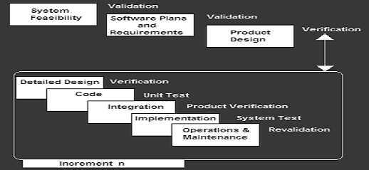
The Incremental Model
Examples
File management system.
Editing functions
Spelling grammar check

Slide 10
The Incremental Model
Strengths
Develop high-risk or major functions first
Each release delivers an operational product
Customer can respond to each build
Uses “divide and conquer” breakdown of tasks
Lowers initial delivery cost
Initial product delivery is faster
Customers get important functionality early

Slide 11
The Incremental Model
Deficiencies
Requires good planning and design
Requires early definition of a complete and fully functional system to allow for the definition of increments
Well-defined module interfaces are required
Total cost of the complete system is not lower

Slide 12
The Incremental Model
When to use this Model
Need for early realization of benefits.
Most of the requirements are known up-front
A need to get basic functionality to the market early
On projects which have lengthy development schedules
On a project with new technology

Slide 13
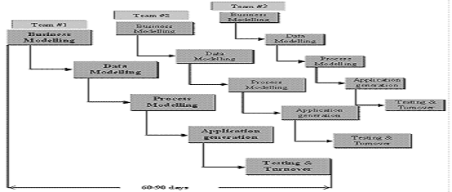
The RAD Model
It is type of incremental software process that emphasis on short development cycle
It is high speed adaptation of water fall model

Slide 14
The RAD Model
Strengths
Customer involved throughout the complete cycle
Minimizes risk of not achieving customer satisfaction and business needs
Focus moves from documentation to code.
Uses modeling concepts to capture information about business, data, and processes
Enables development team to create fully functionally required system with in short period of time (e.g. 60-90 days)
Minimal planning

Slide 15
The RAD Model
Deficiencies
Sufficient human resource
Risk of never achieving closure
Requires a system that can be modularized
Developers and customers must be committed with in abbreviated time frame.
May not be appropriate when technical risks are high
Heavy use of new technologies
Minimal planning

Slide 16
The RAD Model
When to use this Model
Reasonably well-known requirements
User involved throughout the life cycle
Project can be time-boxed
High performance not required
Low technical risks
System can be modularized

Slide 17
Recommended here
Student must surf internet for:
SCRUM
Extreme Programming
Lean Software Development
Joint Application Development
Agile Software Development
Use Wikipedia and / or Google
Many of these articles are also provided

